Slide 1
Introduction to the Reserve Component
TBS Class I
Reserve Affairs
Manpower & Reserve Affairs, HQMC
“Many sustained missions will require augmentation from the Reserve establishment.” – MCDP 1

Slide 2
Intent
Purpose
  Explain RC history and operational employment
  Explain the Total Force concept
  Explain the categories and duty types of the Ready Reserve
Method
  Presentation
End State
  Enhanced understanding of the RC throughout the officer corps
  Enhanced understanding of the capability provided by the RC
  Increased retention of the Marine Corps’ finest

Slide 3
WWI – Interwar Era
  Established by the Naval Appropriations Act 1916
  During WWI, reserve grew from 35 Marines to nearly 6,500
  Rapidly mobilized, seamlessly integrated into active units
  All Reserve Marines were demobilized or discharged by 1922
1925 Gen John A Lejeune, CMC advocates for USMCR
  Organized into 18 battalions and established aviation squadron
  Annual Training (AT) established, only period which was paid
  Became a collection of former Active Duty Marines growing to 10,000 by 1930
  “They are Marines, who from motives of patriotism and love of Corps alone, are devoting their vacation days to the service without reward.”
Naval Reserve Act of 1938 - Required the creation, administration, and pay of a Reserve Component
WWI
Inter-War
WW2
Post-War Era
GW1
OIF/OEF
Notes:
US entered war in April 1917 *bye week
WWI -- Belleau Wood, Soissons, St Mihiel, and Meusse-Argonne
Naval Reserve Act of 1938 establishes USNR/USMCR, funding (pay & training), IRR,

Slide 4
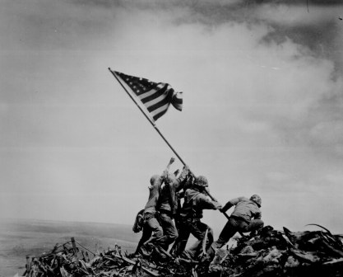
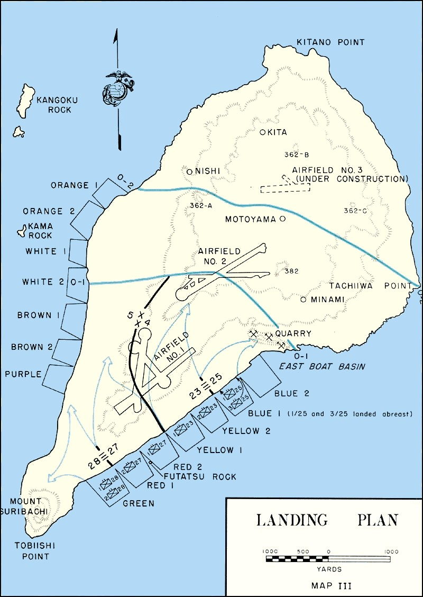
World War II
23 Feb 1945 (D+4)
Inter-War
WW2
Post-War Era
GW1
OIF/OEF
WWI
Notes:
Raised by 6 Marines of the 5th Marine Division (2nd BN, 28th Marines). Many of Marines from 2/28 were from the recently deactivated 3d/4th Parachute Battalions.

Slide 5
World War II
  1940 – Active USMC End Strength: 15,000
  Rapidly generated manpower
  Two Enlistment contracts: “Regular” & “Duration”
Of 589,853 Marines to serve during WWII, 70% were Reservists
44/83 MOH Recipients were Reservists including Pappy Boyington
20 USMCR MOH recipients at Iwo Jima alone
“Our greatest blessing, our greatest strength…when fighting side by side, the labels Reserve and Regular melt away.”
WWI
Inter-War
WW2
Post-War Era
GW1
OIF/OEF
“…Reserve Marines of the World War II era made an invaluable contribution…”
Notes:
1942 : MCB Quantico expanded by 50,000 to accommodate influx of manpower to support the war
Pappy Boyington – Reserve Aviator shot down 28 Japanese aircraft

Slide 6
Post-war Era (1946-1948)
  August 15, 1945 – Armistice signed by Japan
  1945 – USMC strength: 475,000
1947 – USMC strength 92,000
1949 – USMCR strength grows to 129,000
Contracts End
WWI
Inter-War
WW2
Post-War Era
GW1
OIF/OEF
Notes:
Reserves are the cushion to manage rapid inflation/deflation based on operational manpower requirements

Slide 7
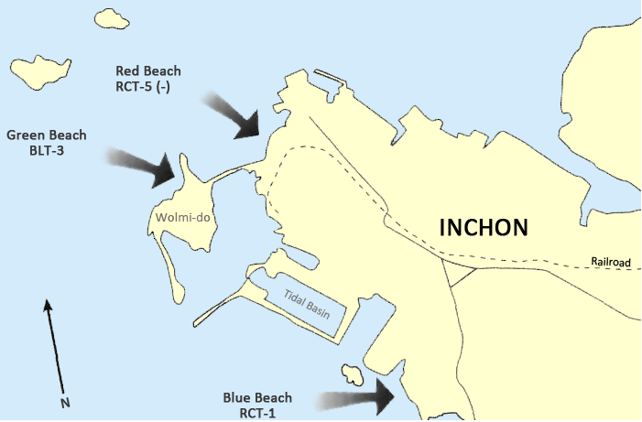
Korean War
“Nearly as many men required to bring it up
to full strength as were contained in the entire FMF. But so great was his confidence in the Marine Corps Reserve
that he did not hesitate to take the responsibility.”
3,459 on 26 July
17,162 on 7 Aug
15 Sep 1950
WWI
Inter-War
WW2
Post-War Era
GW1
OIF/OEF
Notes:
Talk about term “Mass Mobilization” and tie together the strategic asset that the RC represents.
Mass to concentrate combat power
3 B’s of naval strategy: Blockade, Bombardment (13 Sep), Boots (15 Sep)

Slide 8
Korean War
In 1950, 33,000 reservists called up to reconstitute 1st Marine Division
  1st mass activation of Reserve Marines
Validated the need for a Marine Corps Reserve
By 1951 approximately 50% of all Marines serving in Korea were reservists
  130,000 reservists serving on active duty
  Recalled and in war zone in 60 days
WWI
Inter-War
WW2
Post-War Era
GW1
OIF/OEF
Notes:
Talk about term “Mass Mobilization” and tie together the strategic asset that the RC represents.

Slide 9
Vietnam War
USMCR never mass activated for Vietnam service
Used as “strategic reserve” in the event of war with the Soviet Union
Hundreds of Reserve Marines deployed as Individual Augments
Draft/Conscription
  2.2 million service members during Vietnam
  Historically high number of court martials and misconduct
  Abandoned in 1973
December 1972 last man drafted into service
Reorganized to current MAGTF construct
WWI
Inter-War
WW2
Post-War Era
GW1
OIF/OEF
Notes:
Post conflict draw down is much less sever.
Standing armed service becomes a national requirement to counter soviet cold war threats.
The concept changes a draft is intuited.
However, the conclusion of the Vietnam war, when public perception was at a low point, marked the beginning of the all volunteer active force that is cherished today.

Slide 10

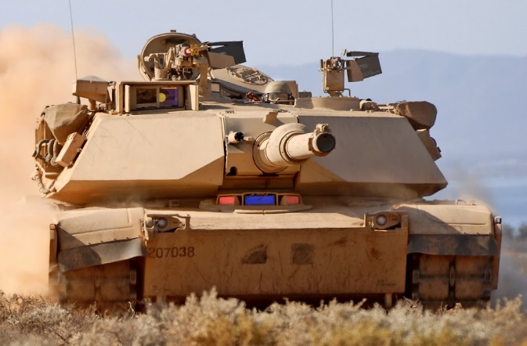
Gulf War
1991
15% of all Marines in theatre
Backfill units in Okinawa
63% of USMCR activated
1994
Marine Forces Reserve officially becomes the largest command in the Marine Corps
The deadliest company in the Marine Corps, the “Reveille Engagement.”
Feb 25, 1991, 32 days after departing their HTC, B Co, 4th Tank Battalion, assigned to 2d Marine Division, destroyed or neutralized 34 Iraqi tanks in 90 seconds.
WWI
Inter-War
WW2
Post-War Era
GW1
OIF/OEF

Slide 11
OIF/OEF
62,688 activated from the IRR alone from 2001-2014
  Averaging 15.5 months activated per individual
100% of SMCR units mobilized ISO OEF
Full SMCR Battalions/Squadrons activated
Unique contributions to the MAGTF → CAG, PRP, Advisor Companies, Airborne ANGLICO
175 KIA serving with USMCR units
WWI
Inter-War
WW2
Post-War Era
GW1
OIF/OEF
Notes:
Resourcing unique capabilities: CAG’s, PRP, linguists, SPMAGTF’s, senior advisors

Slide 12
The USMCR in 2030
CMFR dual-hats as COMMARFORSOUTH
  Oriented to SOUTHCOM AOR ISO Tri-Service Maritime Strategy
IAW FD2030, MFR aligned with II MEF
  Global contingency response force outside of INDOPACOM, individual and unit augmentation
Long-range fires and UDP support to I & III MEF
Specialized capabilities
  Civil Affairs, PRP, 4th LE Battalion, Advisor Companies, airborne ANGLICO, 50% of Marine Corps Artillery
IAW TM2030, reduce administrative and policy hurdles to RC participation
Notes:
Resourcing unique capabilities: CAG’s, PRP, linguists, SPMAGTF’s, senior advisors

Slide 13
What is “the Reserve”…?

Slide 14
The Reserve Component
The RC provides operational capabilities and
strategic depth to meet U.S defense requirements across the full spectrum of conflict…
…enhance the effectiveness of and
sustain the all-volunteer force…
- DODD 1200.17

Slide 15
Doctrinal Definition
Reserve –
1. Portion of a body of troops that is kept to the rear, or withheld from action at the beginning of an engagement, in order to be available for a decisive movement.
2. Members of the Military Services who are not in active service but who are subject to call to active duty.
- MCDP 1-0
Prevent
Culmination

Slide 16
The Total Force Concept
Two components to the Marine Corps Total Force
1. Active Component
2. Reserve Component
Notes:
Based on a foundational enterprise-level belief that positive operational results come from the combination of Active and Reserve Component Marines, Sailors and Marine Civilians working together toward a common goal. – General Neller, MARFORCOM
As of March 2023
~169,000
~32,000
FD
RC: 36,800
AC: 174,600

Slide 17
Reserve Component Structure
Ready Reserve
Standby Reserve
Retired Reserve
Selected Reserve
Individual Ready Reserve
Active Status
Inactive Status
Selected Marine Corps Reserve (SMCR)
Active Reserve
(AR)
Individual Mobilization Augmentee (IMA)
IADT
Notes:
Initial Active Duty for Training (IADT) = Marines on IADT are undergoing initial accession pipeline training

Slide 18
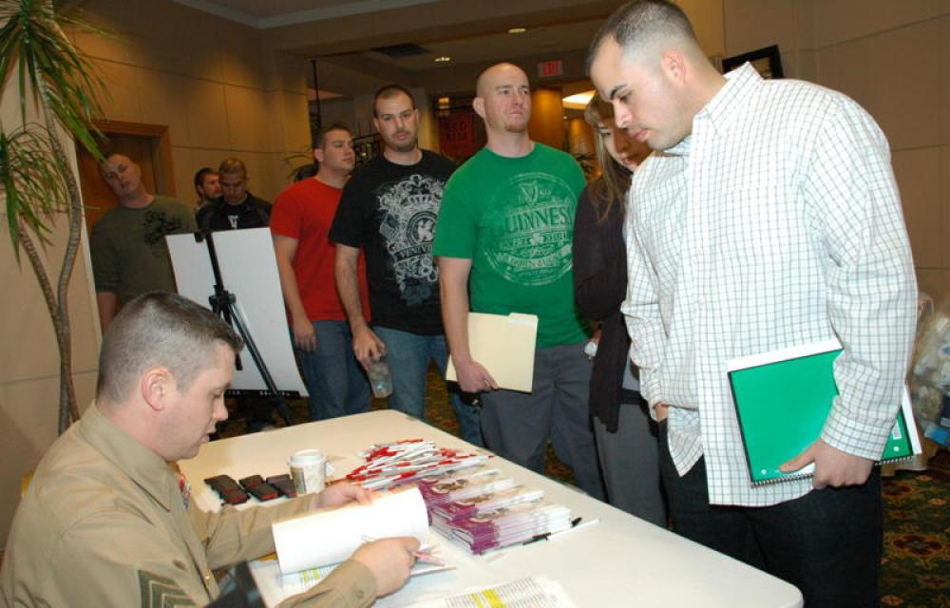
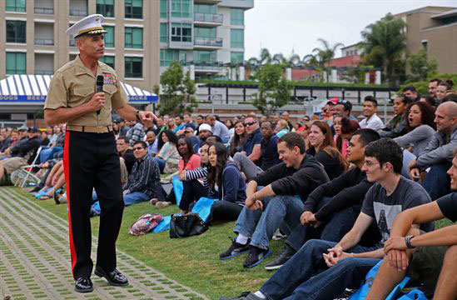
Individual Ready Reserve (IRR)
Ready Reserve
MCIRSA
Commanded by AR Col
Managed by a staff of 45
~ 62,000 Marines
Individual Ready Reserve
Obligations & Requirements of the IRR
Updated Contact Info and Civilian Employment
- Report changes to Physical Health
Maintain basic uniforms
Maintain standards of conduct
Report for involuntary recall to Active Duty
Entitlements : Military ID Card Dependent ID
Support Services TRICARE

Slide 19
Selected Marine Corps Reserve
Ready Reserve
“Drilling Reserve”
1 Weekend per month (average)
2 week Annual Training exercise (average)
Supported by Active Duty Inspector-Instructor Staff
Trained as a unit.
Activated as a unit.
Selected Reserve
Selected Marine Corps Reserve (SMCR)
~ 28,000 Marines

Slide 20
The Active Reserve
Mission – Serve as a critical piece of the USMC’s full-time support to the RC system, in order to facilitate the integration of the Total Force, and assist the AC with their Total Force integration roles and responsibilities.
Provide RC advocacy advice, expertise, and liaison to AC operating forces.
Organizing, preparing and administering policies and regulations affecting the USMCR
Training and instructing
Recruiting and retention
Administration
- MCO 1001.52J
Ready Reserve
Selected Reserve
~2,300 Marines
Officers – 16 OCC Fields
Enlisted – 23 OCC Fields
Assessed via board, career designated for continued service.
Active Reserve
(AR)
Same pay, entitlements, and retirement as AC equivalents.
Notes:
361 officer billets

Slide 21

Individual Mobilization Augmentee
IMA
Attached to AC Structure
Same requirements as SMCR
No defined IDT schedule
Non-obligated
Coordinates via RLO
~2500 Marines
IMA Locations
76 Detachments including Hawaii and Germany
Marine Expeditionary Force’s (MEF)
Marine Component Commands
Joint Staff & Directorates
Separate Detachments
HQMC Directorates
Geographic Combatant Commands
Functional Combatant Commands
Notes:
Individual Mobilization Augmentee (IMA) = support to AC for mass mobilization

Slide 22
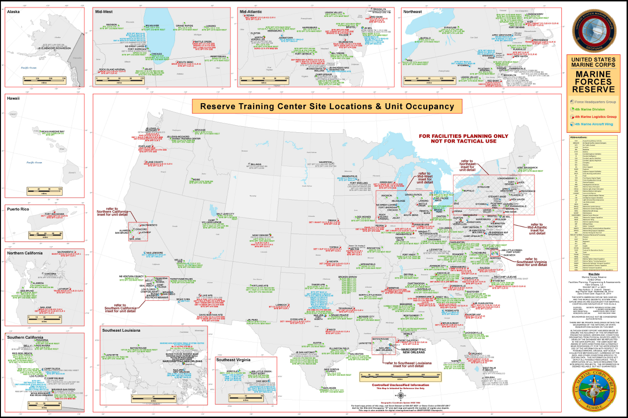
Where is the SMCR…?
158 Sites, 27 Standalone
Located in 47 States; Hawaii, Alaska, D.C., Puerto Rico

Slide 23


4th Marine Division
4th Marine
Division
Marine & Navy Total ~14,000
14th Marines
25th Marines
23rd Marines
2/14
3/14
5/14
1/25
2/25
3/25
1/24
1/23
2/23
3/23
2/24
Comm Co
Truck Co
Anti-Tank Co
Truck Co
4th Combat Engineer Battalion
4th Reconnaissance Battalion
4th Assault Amphibian Battalion
4th Light Armor Reconnaissance Battalion

Slide 24

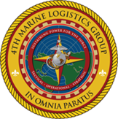
4th Marine Logistics Group
4th MLG
Marine & Navy Total 8,982
CLR-4
4th Medical Battalion
4th Dental Battalion
6th Engineer Support Bn
CLR-45
CLB-23
No Postal, Exchange, Disbursing, EOD, or Air Delivery capabilities
- More Engineer capacity
  3 x Bulk Fuel Co
- Personnel Retrieval and Processing Company (PRP)
CLB-25
LS Company
CLB-453
CLB-451
Comm Co
CBRN Company
Food Svc Company
PRP Co

Slide 25

4th Marine Aircraft Wing
6,962 TOTAL 1,630 Active Component
839 Active Reserve
4,493 SMCR
4th MAW
MAG-41
MAG-49
MACG 48
MATSG 42
VMM
774
MALS 49
VMGR 234
MALS 41
MTCS 48
VMGR 452
HMH 772
MWCS 48
MTS Belle Chase
VMU 4
VMFA 112
MWSS 472
HMLA 773
MACS 24
MTS Andrews
MWSS 471
VMFT
401
MASS 6
MWSS 473
VMM 764

Slide 26
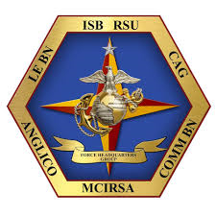
Force Headquarters Group
FHG
4th LE
Battalion
Intel Support Battalion
6th Comm
Battalion
Advisor Co A
Advisor Co B
Advisor Co C
RSU / DPC-W
RSU / DPC-E
3rd ANGLICO
4th ANGLICO
6th ANGLICO
Cyber Def Co A
Cyber Def Co B
1st CAG
3rd CAG
4th CAG
Marine Corps Individual Reserve Support Activity
(MCIRSA)
Notes:
MCAC conducts security force assistance across the spectrum of conflict to enable partner capability in support of Service and joint force requirements.
CAG = inform, influence, shape, and gain access to the cognitive civil environment through targeted and integrated civil reconnaissance and civil engagements to achieve MAGTF objectives.

Slide 27
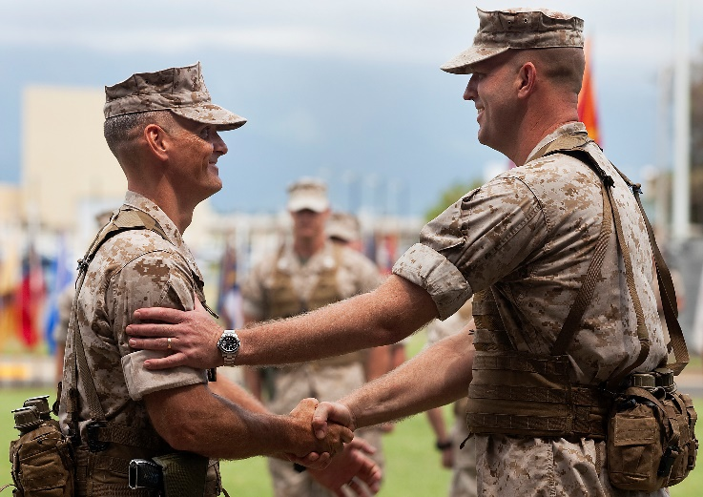
Inspector – Instructor (I-I)
Full time support to the RC (~6,300) is composed of 1/3 AR and 2/3 AC
  Serves as Installation Commander
  Symbiotic Supporting/Supported relationship with SMCR OIC
  Consolidated Memorandum of Receipt (CMR) Responsible Officer (RO)
  Schedules ranges, training areas. Coordinates travel and external support
  Performs personnel administration functions
  Trains, Advises, and Assists SMCR staff
  Manages equipment maintenance
  Aided by Site Senior Enlisted Advisor
Majority are Captains & Majors
Command slated AC/AR O-5/O-6s

Slide 28
Key Points
“Active Duty” is a duty status, not a component or type of Marine
  Use your Reserve manpower
SMCR Marines
  Older, more independent
  Vastly different life experience and capabilities
  Competing priorities, service often unpaid
  Perpetually includes veterans of the last war
Training requirements
  Same school requirements
  Same T&R standards
  Same PME requirements
Notes:
The so what

Slide 29
Conclusion
Categories and Capability of the RC
Active Duty in the RC
Officers understand purpose of the RC
USMC’s finest are retained upon EAS
“Retention is every leader’s responsibility…”
- Gen R. Neller, 37th CMC

Slide 30
Questions
Maj Dean, Jeffrey F.
ROCP Manager, Reserve Affairs, HQMC
jeffrey.f.dean@usmc.mil
O: (703) 784-0537
Capt Speyer, Shane C.
ROCP Assistant Manager, Reserve Affairs, HQMC
shane.speyer@usmc.mil
O: (703) 784-0532
Sgt Dowson, Demond L.
ROCP Admin Chief, Reserve Affairs, HQMC
demond.dowson@usmc.mil
O: (703) 784-0523

