Slide 1
Intro to the Reserve Officer Commissioning Program (ROCP) and the Road to War
TBS Class II
Reserve Affairs
Manpower & Reserve Affairs, HQMC
Prepared by: Capt Speyer, S.C. RAM-4, RA, M&RA, HQMC, 703-784-0532

Slide 2
Agenda
ROCP Introduction
  Who is ROCP
  What is ROCP
ROCP Education Continuum
(Intro to) Reserve MOS Selection Process

Slide 3
Who is RAM-4
RAM-4 is made up of 3 Individuals
  ROCP Program Manager
    Maj Dean, Jeffrey F.
    jeffrey.f.dean@usmc.mil
    O: (703) 784-0537
  ROCP Assistant Program Manager
    Capt Speyer, Shane C.
    shane.speyer@usmc.mil
    O: (703) 784-0532
  ROCP Admin Chief
    Sgt Dowson, Demond L.
    demond.dowson@usmc.mil
    O: (703) 784-0523
Alternative POC is the RAM-4 Official Mailbox:
smb_ram-4@usmc.mil

Slide 4
What is ROCP
ROCP was established in 2007 in order to address a shortage of Jr Officers within the SMCR. Prior to ROCP, SMCR relied mostly on Officers leaving the active component to fill billets.
MARADMIN 021/17
MISSION:
To serve as the primary source of SMCR second lieutenant accessions in order to staff SMCR units according to current manning requirements. The intent of the ROCP is to ensure the RC meets company grade officer staffing requirements so that it may sustain a force that is ready, relevant, and responsive. - MCO 1001R.65
Provide monitor-like functions
  Assign Reserve Officers to MOS/BICs according to staffing needs of the SMCR
  Register all Reserve Officers for required schoolhouses (MCTIMS) pertaining to their PMOS
  Coordinate and Draft PDT (ADOS) orders post-MOS school graduation.
Provide Reserve Education and Mentorship during the BOC.

Slide 5
ROCP Education Continuum
ROCP Course Objectives
Intro to the RC (entire BOC) (30mins)
Intro to ROCP and the Road to War (ROCP Students) (15 mins)
Introduce BOC to the Total Force concept, RC history and employment. Introduce Reserve Officers to ROCP and the Reserve MOS slating process.
I
II
III
Leadership and Counseling in the SMCR (30 mins)
Discuss unique leadership dynamics inherent in the SMCR. Provide tools for reserve counseling.
IV
Provide extensive guidance and information pertaining specifically to the ROCP MOS selection process
ROCP MOS Slating process (30 mins)
V
Introduce ROCP Officers to the typical operating cycle of an SMCR unit. Detail Reserve pay, drill types, and retirement within a Reserve career.
Planning and Administration in the SMCR (30 mins)
ROCP Mentorship Panel (~60 mins)
Following MOS assignments, provide ROCP Officers the opportunity to conduct open-forum discussions regarding Occfield-specific issues and challenges.
Mentorship
Transitioning to the SMCR (90 mins)
Educate on IADT transition, prepare for PDT, service in the SMCR, reduce RFIs before departure
VI
Exploitation Plan:
ROCP schedule intuitively linked to BOC schedule through phased approach
Optimize ROCP Officer bandwidth during BOC by back-loading pertinent information about the SMCR
Standardized template for ROCP support to all BOCs
ROCP provides augmented support of retention mission by providing mentorship and career-minded education
ROCP provides continuity of guidance and support beyond BOC graduation.

Slide 6
ROCP Education &
Mentorship Continuum
Graduation
Class 6: Post-BOC Transition
(Week 24)
Transition
RC Mentorship Panel (Week 23)
Class 5: Planning and Administration in the SMCR (Week 22)
MOS Assignment (~Week 21)
Assign
Final MOS Preference Submitted (Week 20)
Class 4: ROCP MOS Slating Process (Week 17)
Class 3: Leadership and Counseling in the SMCR (Week 6)
Inform
Class 2: Intro to ROCP and Road to War Brief (Week 2) (You are here)
TBS Check In
Class 1: Intro to the Reserve (Week 2)
Exploitation Plan:
ROCP schedule intuitively linked to BOC schedule through phased approach
Instruction and mentorship throughout the BOC POI without extended gaps between contact
Standardized template for ROCP support to the BOCs
RA provides mentorship through mentor assignment, increased regular contact with and guidance to ROCP Marines
Tracking and mentorship continues for Mike Company Marines who gain familiarity with RA personnel through Education Continuum

Slide 7
(Intro to) Reserve MOS Selection Process
Available MOS Options
FLEX vs GEO
Unit Assignment and Travel Considerations
Additional Considerations

Slide 8
Available MOS Options
0102 – Manpower Officer
0203 – Ground Intelligence Officer
0204 – Human Intelligence Officer
0206 – Signals Intelligence Officer
0207 – Air Intelligence Officer
0302 – Infantry Officer
0303 – Light Armored
Reconnaissance Officer
0402 – Logistics Officer
0602 – Communications Officer
0802 – Field Artillery Officer
1302 – Combat Engineer Officer
1803 – Assault Amphibious
Vehicle Officer
3002 – Ground Supply Officer
5803 – Military Police Officer
6002 – Aircraft Maintenance
Officer
6602 – Aviation Supply Officer
7208 – Air Support Control Officer
7210 – Air Defense Control Officer
7220 – Air Traffic Control Officer
  Ground MOSs only – no 3404, 4502, 4402, 7204, 75xx

Slide 9
FLEX vs GEO
FLEX Contract (You say MOS is priority)
  Geographic location remains significant, but not inhibitor
  Student initials paragraph 3b on Service Agreement
  Benefit – Increases MOS options, serves production needs
  Risk – Potential for out-of-state unit assignment
GEO Contract (You say Location is priority)
  Assigned a unit within 150 miles of primary residence
  SPC evaluation and MOS preference remain significant
  Risk – Under/Over-assigning MOS’s of need

Slide 10
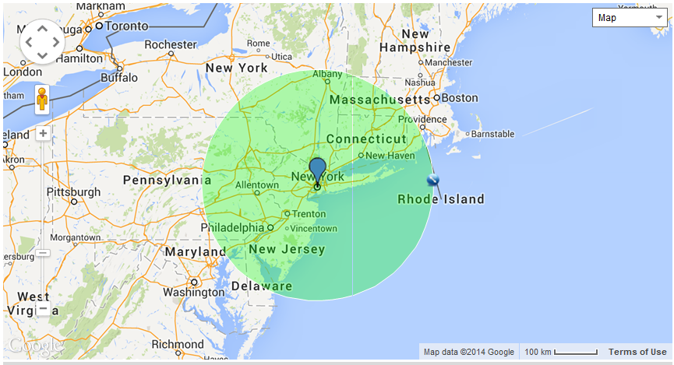
FLEX vs GEO
GEOGRAPHIC CONTRACT
7208
6002
0302
0302
None
0802
0204, 0602
0302, 0602
None
None
0802,6602
1302

Slide 11
FLEX vs GEO
FLEX CONTRACT
0402, 0102, 3002
0207, 6602
1803, 5803, 0102
7208
6002
0302
0302
None
0802
0204, 0602
0302, 0602
0203, 0302, 0402
None
None
0802,6602
0204, 7210, 6002
1302

Slide 12
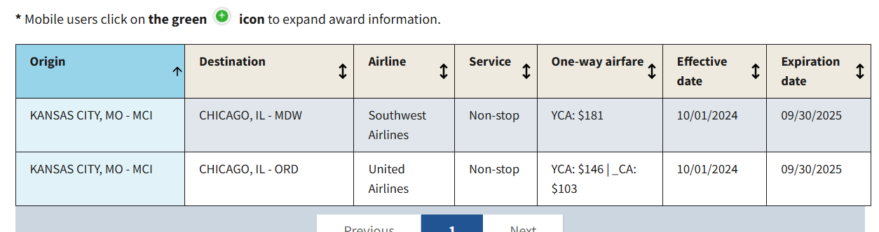



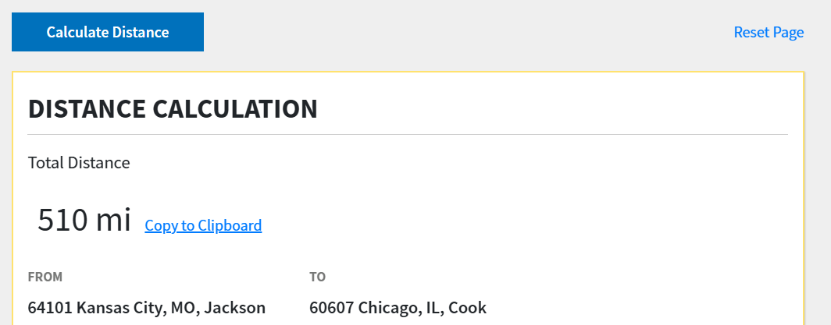
Unit Assignment and Travel Considerations
1803
1803
1803
1803
0602
0602
0602
0602
0602
0602
0602
510 x $.22 = $112.20
$224.40
0602

Slide 13
Additional Considerations
Formal Considerations
NEEDS OF THE MC
Quality Distribution
    TBS Performance
Student Suitability
    TBS Performance
Student Preference
    Submitted by Student
    SPC Counseling Feedback
Unique or Additional Considerations
    Home City, State
    Education
    Prior Enlisted MOS
**Per the TBS MOS Assignment Handbook**
  Informal Considerations
  HOR Proximity to potential unit/MOS regardless of GEO or FLEX Contract
  Aged vacancies within Billet
  Units with two or more vacancies in the same MOS
  Provide even distribution among MSCs
  MOS School availability and timing

Slide 14
Questions
Maj Dean, Jeffrey F.
ROCP Manager, Reserve Affairs, HQMC
jeffrey.f.dean@usmc.mil
W: (703) 784-0537
Capt Speyer, Shane C.
ROCP Assistant Manager, Reserve Affairs, HQMC
shane.speyer@usmc.mil
W: (703) 784-0532
Sgt Dowson, Demond L.
ROCP Administrative Chief, Reserve Affairs, HQMC
demond.dowson@usmc.mil
W: (703) 784-0523

