Slide 1
HQMC Reserve Affairs (RA)
Reserve Affairs Personnel Management (RAM)
Individual Mobilization Augmentee (IMA) OpSponsor Roles and Responsibilities

Slide 2
Agenda
Purpose of the Brief
Operational Sponsor Role
Command Relationships
Operational Sponsor Tasks per MCO
Purpose of IMAs
Inactive Duty Training (IDT)
Additional Paid Drills (APDs)
Reserve Retirements
Common Issues
Operational Sponsor Tools

Slide 3
Purpose
Director of RA is tasked to “conduct IMA Program management annual training for organizations and commands.”
Introduce and familiarize new Operational Sponsors with their roles and responsibilities in the IMA Program

Slide 4
Operational Sponsor Role
MCO 1001.62C
  Manage IMA manpower and administration within the organization. The OpSponsor will act as the advocate and primary liaison while coordinating IMA manpower management concerns with Operational Groups and Commands. The OpSponsor can also facilitate command responsibilities (drill management, orders authentication) if responsibilities are delegated to the OpSponsor by the command and the relationship is approved by the unit with IMA on the T/O.

Slide 5
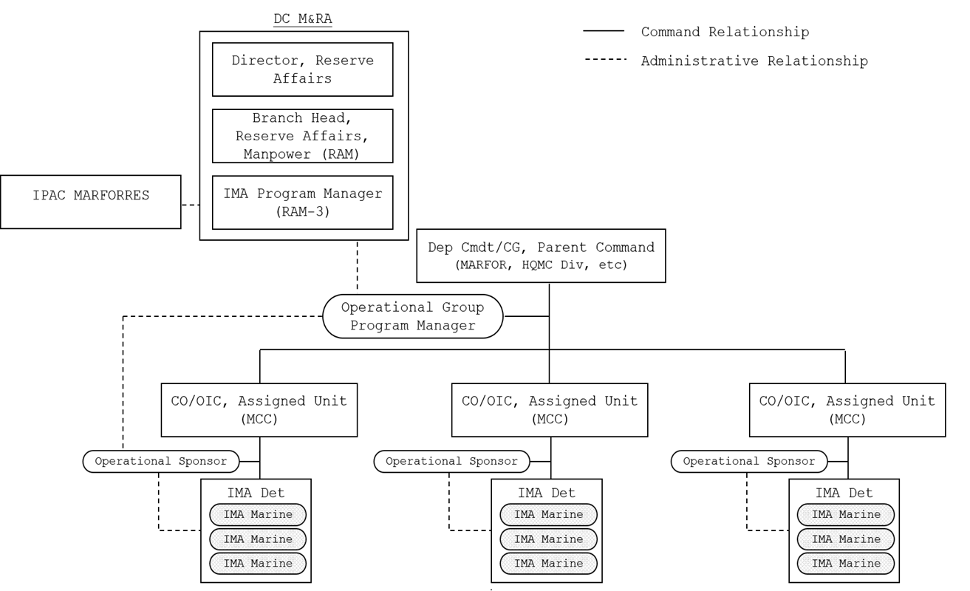
Command Relationships

Slide 6
Operational Sponsor Tasks
Coordinate IMA manpower management concerns with the OpGroup Program Manager and owning Commands.
Review organizational requirements and submit data in conjunction with IMA structure/manning review
Submit officer and enlisted authorized manning requirements to the IMA Program Manager via the OpGroup Program Manager.
Manage on-hand staffing to ensure IMA manpower does not exceed 100% of officer and enlisted authorized manning. OpGroups may temporarily surge to 110% of authorized manning in order to accommodate turnover and transfers.
Advertise BICs, via RTAMMS, three to six months prior to the end of a current tour. Ensure all mandatory billet qualifications are listed in the advertisement remarks. Failure to list a necessary qualification is not sufficient justification to reject an otherwise qualified candidate.
Facilitate interviews with potential new joins and Marines requesting IUTs
Schedule and support AT and other training requirements as necessary.

Slide 7
Operational Sponsor Tasks (cont.)
Oversee drill schedule in compliance with a satisfactory anniversary year. Develop and publish AT plans for all mandatory participants.
Submit activation requests to CMC (MMIB) IAW MCO 3000.19B & MCO 1001.61A
Ensure Marines complete travel vouchers with proper documentation.
Manage and facilitate approval of telecommute requests IAW MCO 1001R.1L w/CH1
Draft, and route ADOS, AT, off-site IDT, and medical orders via MROWS. Requests for extended or additional ATs will be initiated in MROWS and submitted to the IMA Program Manager with justification, to include the reason for the additional days.
Review and process lodging reimbursement requests via DTS local voucher.
Per SECNAVINST 6120.3A, Facilitate medical and dental requirements including an annual Periodic Health Assessment (PHA), and dental exam as directed by the command. Assist the Command Limited Duty Coordinator in the processing of TNPQ and LOD cases.

Slide 8
Operational Sponsor Tasks (cont.)
Endorse requests for IUTs, extensions, and voluntary transfers to the IRR. Ensure appropriate checklists for IUTs and extensions are completed and endorsed. Ensure assigned IMA are educated on assignment requirements, limits, and opportunities.
Submit requests for involuntary transfer of IMA personnel to the IRR to Dir RA, via OpGroup Program Manager.
Review and submit all administrative requests via MOL Electronic Personnel Action Request (EPAR) to MARFORRES IPAC.
Per MCO P1070.12K W/CH1 (IRAM), Conduct records audits for all required occasions and forward via EPAR to MARFORRES IPAC.
Submit requests for inter-service transfer to Dir RA.
Coordinate with the command to facilitate the accomplishment of command tasks. This includes, but is not limited to, administrative, promotion, career retention, legal, medical, dental, awards, PFT, CFT, and command sponsored training.

Slide 9
Individual Mobilization Augmentee
Individual Mobilization Augmentee (IMA)
  The Purpose of the IMA is to facilitate the rapid expansion of AC organizations to meet wartime military manpower requirements, specifically by providing individual reserve manpower that can be accessed during the initial stages of an emerging crisis, prior to mobilization of the IRR.
  ***IMA billets are either paid or unpaid. Paid billets are for Marines joined as IMAs and count against IMA end strength.
IMA Marines are required to perform a minimum:
  12 days of Annual Training (AT) – (13 with 1 travel day)
  48 IDT training periods per fiscal year (FY) are available.
***To be credited with a full year of qualifying service, the Reserve Marine must earn at least 50 Reserve retirement credit points during the anniversary year. IMAs, who do not drill regularly on a monthly basis, must schedule and manage their drills carefully to ensure consecutive drills are reported to also accommodate the anniversary year requirement.

Slide 10
Inactive Duty Training (IDT)
Inactive Duty Training (IDT):
  IDT is performed by members NOT on AD, AT, or ADT
    Regularly scheduled IDT (Mainly SMCR)
    Additional IDT periods
    Voluntary IDT (IMA)
    No IDT travel reimbursement for IMAs
IDT parameters:
  Provides individual or unit readiness.
  May NOT be used for completing correspondence courses.
  Will NOT be performed in a designated imminent danger area or hazardous duty location.
A Reservist shall be considered in an IDT status:
  Beginning at the time of arrival at the designated IDT location
  While at government furnished quarters when remaining overnight for the purpose of commencing one or more consecutive IDT periods.

Slide 11
Inactive Duty Training (IDT) cont.
  All paid IDT periods shall:
    Not be less than four hours in duration
    With the exception of FHDs, no more than two IDT periods may be performed in any calendar day.
    Where practical, multiple IDT periods over consecutive days shall be used to maximize training
Off-site IDT:
  A Reservist executing off-site IDTs pursuant to government funded orders shall be considered in an IDT status while traveling to and from the IDT site.
  Such status shall continue until the member completes the final IDT period on the last day of such periods

Slide 12
Inactive Duty Training (IDT) cont.
Voluntary IDT in a Non-Pay status:
  Marines may voluntarily perform special additional duties as IDT periods for retirement points only (without pay).
  Two types
    Associate Duty
    Appropriate Duty
Associate Duty
  Associate duty is IDT for retirement points only (non-paid) to enable members of the IRR, IMA and the ASL to perform IDT on an affiliated basis with a Reserve or AC unit. The intent of associate duty must be to enhance the Reserve Marine’s
Appropriate Duty
  Appropriate duty is IDT for retirement points only (non-paid) that unit commanders authorize for Reserve Marines under their cognizance to attend special functions or to perform certain tasks. Appropriate duty orders may be issued to members of the SelRes, IRR, and ASL.

Slide 13
Additional Paid Drills (APDs)
Additional Paid Drills (APDs)
  Additional IDT Periods are a sub-category of IDT that improve readiness by providing the required and necessary training to attain and maintain designated readiness levels. They are performed by members of the SelRes and will be accounted for separately from normal unit or individual training periods (do not count toward the 48 regularly scheduled IDT FY authorization). The three categories of additional IDT periods are:
    Additional Training Period (ATP)
    Readiness Management Period (RMP) N/A
    Additional Flight Training Period (AFTP)

Slide 14
Additional Paid Drills (APDs) cont.
Additional Training Period (ATP)
  ATPs are authorized for accomplishment of required training, as defined by a unit's wartime mission or a member's CO/I-I/OIC/OpSponsor.
  The ATP may be used only for the preparation of training programs, lesson plans, training aids, training rehearsals, unit training, administration, and support functions.
  May not be used in addition to, or as a substitute for, Additional Flying Training Periods (AFTPs).
  DC M&RA (RA) will establish control procedures to manage ATPs provided to support IMAs.
  Except for aircrew members, the combination of ATPs and Readiness Management Periods (RMPs) will not exceed 72 in each FY for each person.
  ATPs are not authorized to perform general administrative functions, to prepare for inspections, to prepare for AT, or to perform vehicle maintenance and other duties which are not directly related to training programs.
*Only Reserve members in a satisfactory IDT status may perform ATPs.

Slide 15
Additional Paid Drills (APDs) cont.
Additional Flying Training Period (AFTP)
  AFTPs are authorized for aircrew members for conducting aircrew training and combat crew qualification training. AFTPs will be used to attain and maintain aircrew flying proficiency and sustain mobilization readiness.
Readiness Management Periods (RMP)
  RMPs are intended to support the following functions in preparing for unit training: the ongoing, day-to-day operations of units; accomplishing unit administration; training preparation; support activities; and maintenance functions.
  RMPs shall be used only where sufficient active-duty personnel are not available or specifically assigned to accomplish these duties.
  Only Reservists in a satisfactory drill status may perform RMPs.
  An RMP may be performed on the same day that another IDT period is performed.
  In order for a Reservist to receive credit for an RMP, the RMP period must be a minimum of four hours.
  Not more than 1 RMP will be performed by an individual on the same day.

Slide 16
Additional Paid Drills (APDs) cont.
Notes:
* - Aircrew members may use up to 72 AFTPs annually, however, the combination of ATPs, AFTPs, and RMPs shall not exceed 84. Requests to exceed 84 additional IDT periods may be submitted via the chain of command to the SECNAV for up to a maximum of 96.
** - Only (1) RMP per calendar day may be executed. (1) RMP may be combined with (1) other training period type for a maximum of (2) training periods per calendar day.
Additional IDT Period Summary
Type of Duty | Minimum Time Required | IDT Points | Daily Maximum | Annual Maximum
IDT | 4 hours | 1 | 2 | 48
ATP | 4 hours | 1 | 2 | 36
AFTP | 4 hours | 1 | 2 | 72 (84)
RMP | 4 hours | 1 | 1** | 36

Slide 17
Reserve Retirement
Reserve Retirements
  A Reserve Marine must perform at least 20 satisfactory years of qualifying service to be eligible for retirement with pay.
  Members of the RC who have completed at least 20 qualifying years of service should submit their request for transfer to the Retired Reserve Awaiting Pay in writing, per Appendix J, to their reporting unit commander where this request will be entered into the MCTFS.
  This request must be submitted and certified between 4 and 14 months prior to the requested date of transfer to the Retired Reserve Awaiting Pay at age 60 list.
  To be credited with a full year of qualifying service, the Reserve Marine must earn at least 50 Reserve retirement credit points during the anniversary year. IMAs, who do not drill regularly on a monthly basis, must schedule and manage their drills carefully to ensure consecutive drills are reported to also accommodate the anniversary year requirement.

Slide 18
Common Issues
Review all tasks within the order.
Ext & IUT are being submitted with missing or outdated HtWt, PFT, CFT, AT/ADT.
Drills & Orders submitted for Marines that are a week from or passed their EOT.
MOS waivers for Marines with no military or civilian experience.
Marines 30-days from RECC or past their RECC. If the RECC has passed, Marines will be hard dropped and need to go through a PSR to re-join the Marine Corps.
Extensions are not being submitted for Marines that are on orders for longer than 30-days.
Over executing on AM may restrict IUTs and extensions for the OpGroup.
Ensure Marines are completing their FITREPs.
No adverse FITREPs for Marines that Fail PFTs, CFTs, BCP, etc.

Slide 19
Questions

