Slide 1
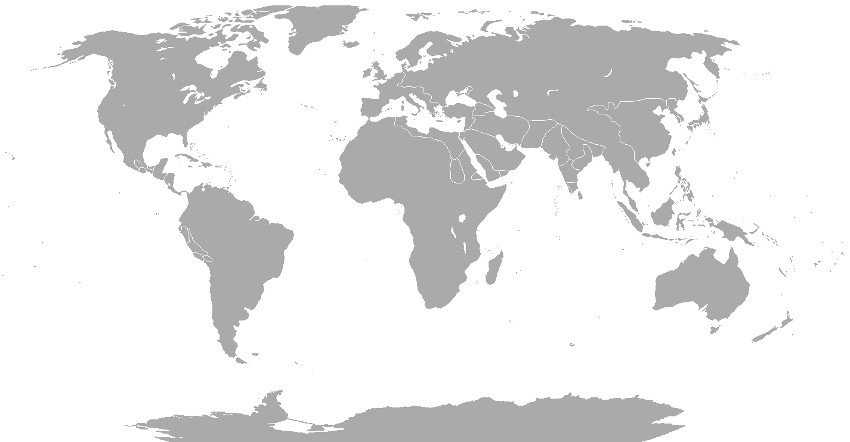
UNCLASSIFIED/FOUO
MARINE CORPS SUPPORT FACILITY
MARINE FORCES RESERVES
INSTALLATION PERSONNEL ADMINISTRATION CENTER
NEW ORLEANS
IPAC WORLDWIDE SUPPORT BY THE NUMBERS
IRR: 59,417
IMA: 2,912
SMCR: 683 (SPTFAC: 242 , ISB: 441)
AD/AR: 1,047 (MFR: 842, MFS: 132, ISB: 73)
TOTAL: 64,059
DATA GENERATED 0840 24 APR 2024

Slide 2
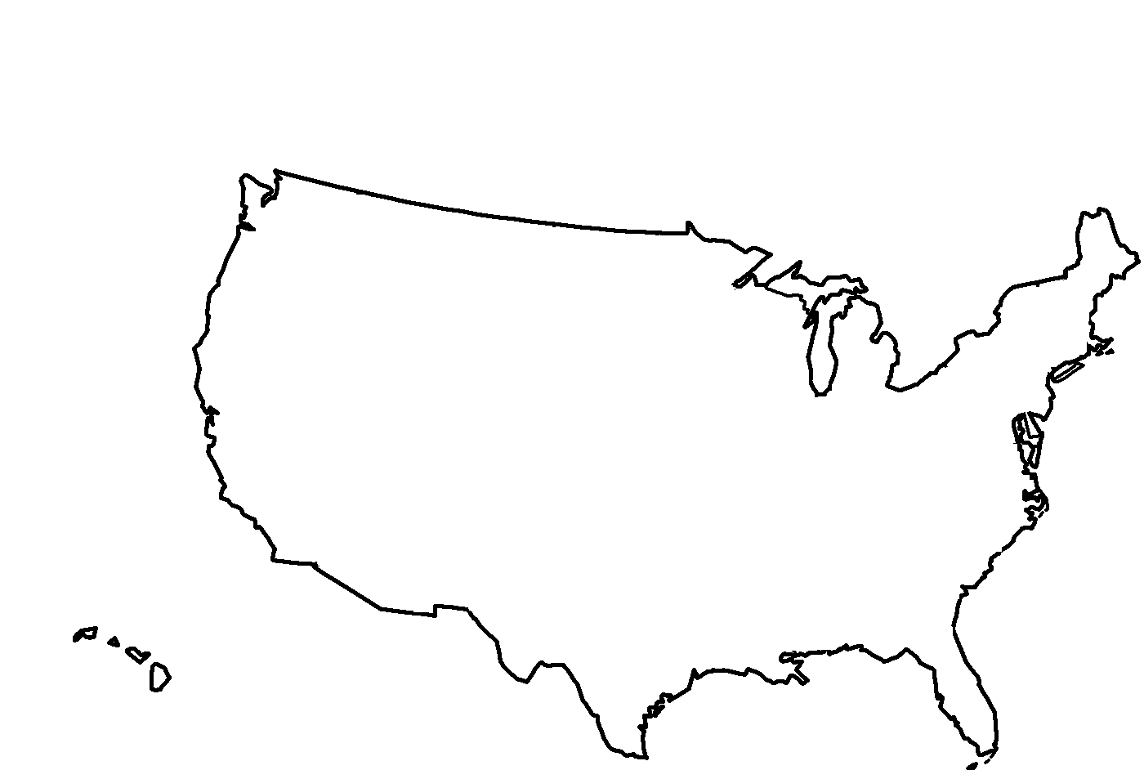
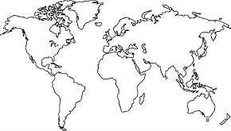
UNCLASSIFIED/FOUO
MARINE CORPS SUPPORT FACILITY
MARINE FORCES RESERVE
INSTALLATION PERSONNEL ADMINISTRATION CENTER
NEW ORLEANS
Great Lakes
A Co ISB 2d Plt
Quantico
Anacostia
Aurora
Ops Co ISB Topo Plt
B Co ISB HQ
B Co ISB 1st Plt
Ops Co ISB HQ
Ops Co ISB IMG Plt
USTRANSCOM SCOTT AFB IL
DS Co ISB DST 5
DS Co ISB HQ
DS Co ISB DST 1
DS Co ISB DST 2
DS Co ISB DST 3
MARCORCYBER, MCSB
FT GEORGE MD
IMA DET
Brooklyn
USSTRATCOM IMA DET
OFFUTT AFB NE
MARCORCYBER, MCSB
FT GEORGE MD
IMA DET
B Co ISB 2d Plt
USSTRATCOM IMA DET
OFFUTT AFB NE
DC, CD&I, DLOG, FCOM, MSCG, SAFE, HQMP, HQRA, HQTE, HQTR, MCIS, JECC, M4LP, MCB, MCRC, OMFR, SSSO, SYSC,
TECQ, WWR1, AVIA, JCOM
HQC4, IGMC, LSSS, MCRC VIRGINIA AREA IMA DET
CO B
DC, CD&I, DLOG, FCOM, MSCG, SAFE, HQMP, HQRA, HQTE, HQTR, MCIS, JECC, M4LP, MCB, MCRC, OMFR, SSSO, SYSC,
TECQ, WWR1, AVIA, JCOM
HQC4, IGMC, LSSS, MCRC VIRGINIA AREA IMA DET
CO B
USNORTHCOM IMA DET
PETERSON AFB CO
PROD
MCAGCC 29 PALMS IMA DET
San Diego
MCAGCC 29 PALMS IMA DET
Camp Lejuene
II MEF, 2MAW, MCAS, MCBE, MSOC,
RSUE-E, CAMP LEJEUNE IMA DET
II MEF, 2MAW, MCAS, MCBE, MSOC,
RSUE-E, CAMP LEJEUNE IMA DET
A Co ISB HQ
A Co ISB 1st Plt
Ops Co ISB Coll Cell
Ops Co ISB OSINT Cell
DS Co ISB DST 4
MCAS BEAUFORT IMA DET
LOGCOM ALBANY GA IMA DET
MCAS BEAUFORT IMA DET
LOGCOM ALBANY GA IMA DET
San Antonio
Mobile
MARFORPAC, JICP, MCB, USPACOM HAWAII IMA DET
A Co ISB 3d Plt
BS Co ISB HQ
BS Co ISB GSP
BS Co ISB METOC
Ops Co ISB All Src Plt
4DIV, ESDR, MARFORNOR, 4MLG,
DCIL, MCIRSA, MCLO, MFR1, MFR7
New Orleans
HQTRS ISB Co
MARFORSOUTH PEP
MARINE CORPS FORCES KOREA IMA DET
4DIV, ESDR, MARFORNOR, 4MLG,
DCIL, MCIRSA, MCLO, MFR1, MFR7
CCOM, FCEN, FSOU, SCOM, USSO
FLORIDA IMA DET
Columbia
Peru
Chile
Dominican Republic
Brazil
Argentina
III MEF, 1MAW, MCBB OKINAWA JAPAN IMA DET

Slide 3

UNCLASSIFIED/FOUO
READY RESERVE BRANCH
IPAC Director
CWO5 Villa
x8913
IPAC SNCOIC
MGySgt Roseboro
x7902
Deputy Director
GS12 Byes
x7901
Cust Svc / Inbound
GS11 O’Toole
x8992
MSgt Newton
x7940
Maintenance
CWO3 Gallegos
x8950
SSgt Smith
x7997
Outbound
GS09 Laphand
x8911
GySgt Johnson
x8956
Ready Reserve
CWO3 Jeffries
504-697-7922
MSgt Lucaterodiaz
504-697-8952
Reserve Travel
CWO2 Yque
x7979
SSgt Hernandez
x8920
Quality Assurance
GS11 Lee
x8987
SSgt Sweeny
x7947
Team 1 *00-33
CWO2 Polk
504-697-7922
SSgt DeOleo
504-697-7988
Team 2 *34-66
GS9 Jackson III
504-697-8921
SSgt Spruill
504-697-8957
Team 3 *67-99
GS9 Addison
504-697-8957
*Gapped
504-697-7944

Slide 4
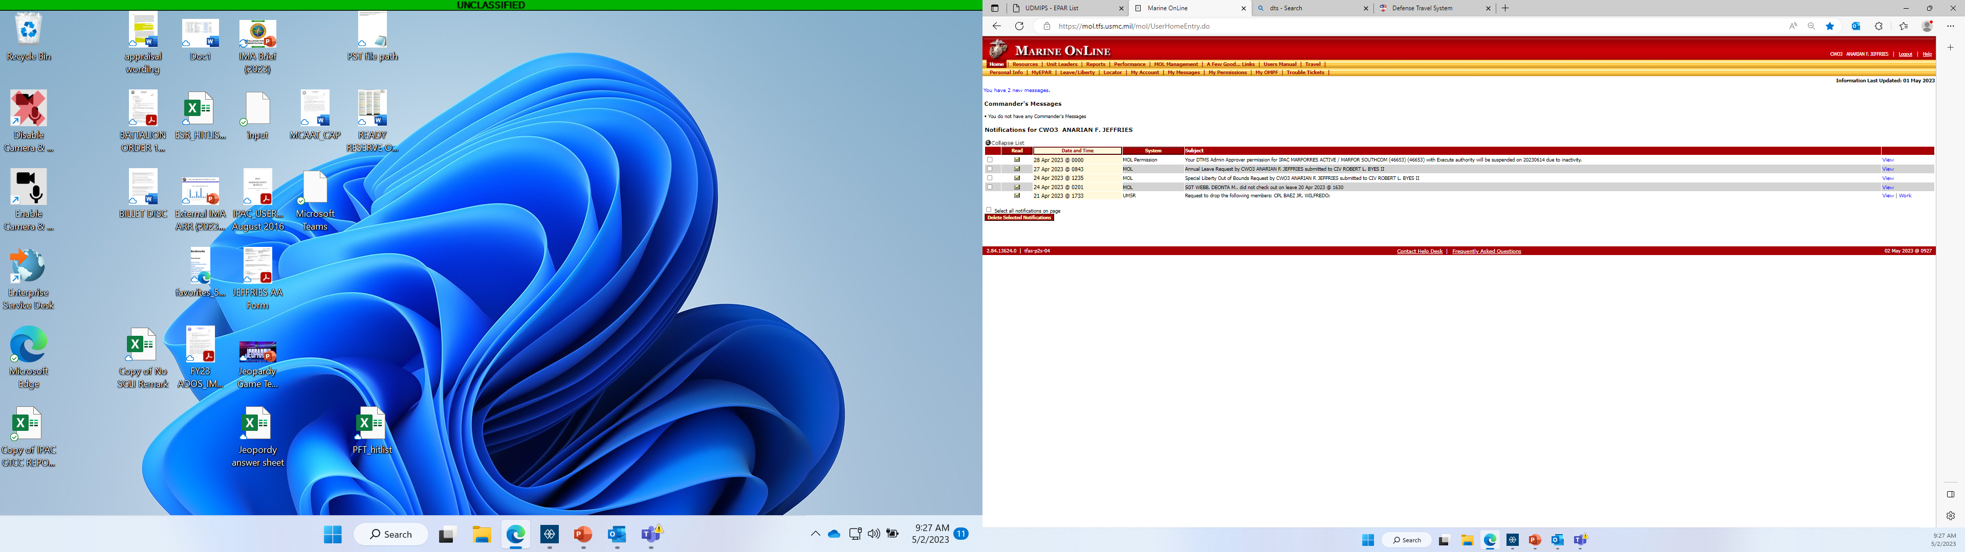
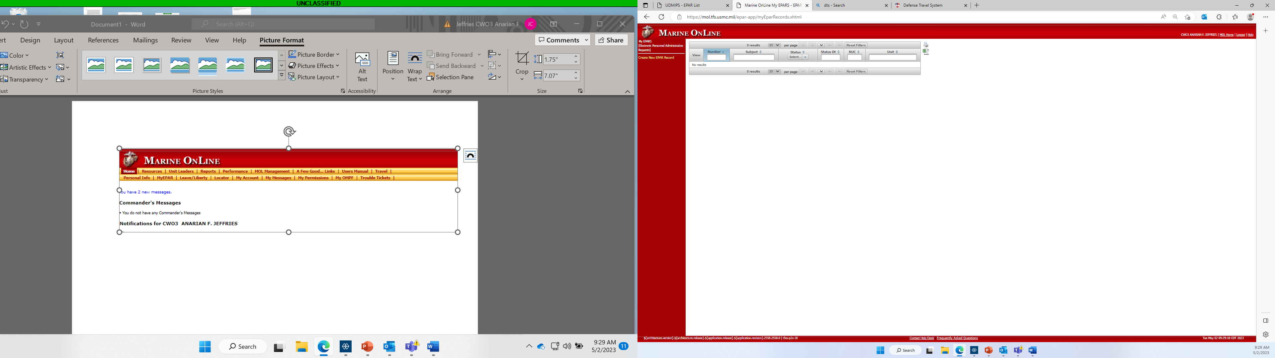
UNCLASSIFIED/FOUO
READY RESERVE BRANCH
Method(s) to request assistance.
Organization Mailbox
MFR_CSI@USMC.MIL
MOL EPAR
*EPAR(s) /OMB requests are received and worked within 5 working days

Slide 5
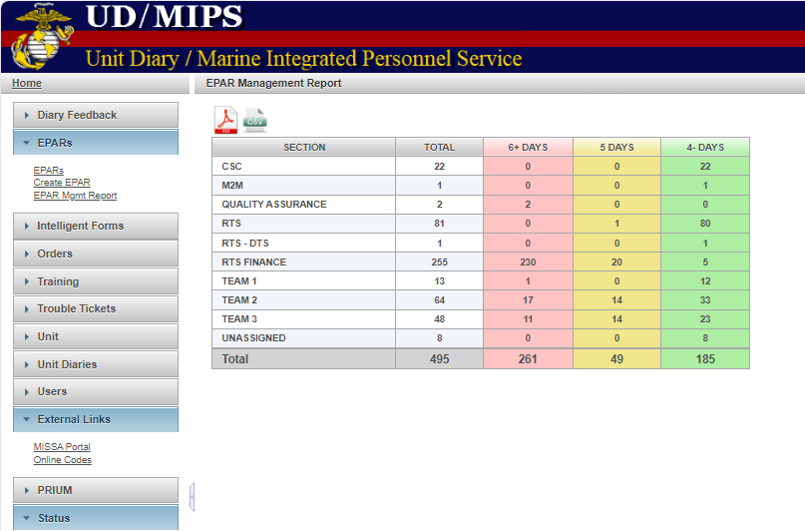
UNCLASSIFIED/FOUO
READY RESERVE BRANCH
EPAR INBOX
EPARs are typically worked within 5 calendar days upon receipt.
DIVISION OF LABOR
Requests are processed based on the last two digits of the members EDIPI and the corresponding TEAM.
Team 1: 00 to 33
Team 2: 34 to 66
Team 3: 37 to 99

Slide 6
UNCLASSIFIED/FOUO
READY RESERVE BRANCH
WORKLOAD / CURRENT STATS
As of 24 April.
CY24 EPARs = 3,579 ~223 per week.
CY24 OMB = 305 ~19 per week.
CY24 Unit diaries = 2,226
CY24 OMPF docs = 1,846
ONGOING TRENDS
-IRR transfer requests with pending drills.
-Incorrect/missing medical endorsement for strength category updates (i.e., TNPQ, NPQ, Pregnancy)
-Incorrect/missing unit endorsements for training updates (i.e., CPTR ltr, legible NAVMC).
-CRCR corrections.
-Primary residence documentation for State Department employees. (MarAdmin 204/15).
-AVIP restoration (75XX).
WHAT’S HAPPENING WELL!
-Accurate and timely join package / IUT submissions.
-Timely reenlistments /extensions.
-Streamlined manpower and staffing functions. IPAC/RAM/OpSponsor communication!
-Timeliness + accuracy + records management = Tier II satisfactory MCAAT results.

Slide 7
UNCLASSIFIED/FOUO
RESERVE TRAVEL BRANCH
IPAC Director
CWO5 Villa
x8913
IPAC SNCOIC
MGySgt Roseboro
x7902
Deputy Director
GS12 Byes
x7901
Cust Svc / Inbound
GS11 O’Toole
x8992
MSgt Newton
x7940
Maintenance
CWO3 Gallegos
x8950
SSgt Smith
x7997
Outbound
GS09 Laphand
x8911
GySgt Johnson
x8956
Ready Reserve
CWO3 Jeffries
x7922
MSgt Lucaterodiaz
x8952
Reserve Travel
CWO2 Yque
x7979
SSgt Hernandez
x8920
Quality Assurance
GS11 Lee
x8987
SSgt Sweeny
x7947
Sgt Campbell
Cpl Almo
Sgt Webb
Cpl Baltazar
Sgt DelmasPerez
Cpl Rudolph

Slide 8
UNCLASSIFIED/FOUO
RESERVE TRAVEL BRANCH
              Positive Trends
Members communicate well for clarity and understanding when asked to provide more documentation or information.
Members are quick and keen to provide corrections on claims.
Members are actively submitting EPARS for final IPPs and travel claims
          Travel Claim Trends
DD Form 1351-2 not properly filled out. (ex., signature missing on block 21A, actual travel location(s) on 1351 does not match MROWS orders).
The reporting/detaching endorsements do not indicate proper entitlements regarding messing/lodging, and the endorsement dates do not match the dates on the MROWS orders.
The DTS voucher dates do not match the MROWS orders. Marines are being paid per diem outside of authorized dates, requiring modifications to MROWS.
Claims with no valid receipts.
MROWS Orders Trends
Members executing travel in DTS without MROWS orders.
MROWS orders for ECD Marines stating messing is provided at no cost.
Units modifying MROWS for different dates after the final IPP was run (members are being checked or getting underpaid).

Slide 9
UNCLASSIFIED/FOUO
RESERVE TRAVEL BRANCH
MROWS WITHOUT FINAL IPPS AND TRAVEL CLAIMS
FUNDS ALLOCATED
Pay & Allowances: $103,171.46
Travel: $31,712.82
Per Diem: $1,829,397.16

Slide 10
UNCLASSIFIED/FOUO
RESERVE TRAVEL BRANCH
UNRESPONSIVE MEMBERS
Initial email sent to members upon completion of MROWS orders.
Reminder email sent 45 days after initial email notification sent.

Slide 11
UNCLASSIFIED/FOUO
RESERVE TRAVEL BRANCH
MEMBERS FINAL NOTIFICATION
Final email notification sent 90 days after the initial email.
Failure to respond to the final email places members at risk of having incremental IPPs checked and MROWS orders canceled.

Slide 12
UNCLASSIFIED/FOUO
MARFORRES IPAC
RESERVE TRAVEL POINTS OF CONTACT
CWO2 GUSTAVO YQUE
GUSTAVO.YQUE@USMC.MIL
(504) 697-7979
SSGT STEVEN HERNANDEZ
STEVEN.M.HERNADEZ@USMC.MIL
(504) 697-8920
RTS OMB
OMB.MFR_IPAC_RTS@USMC.MIL

Slide 13
UNCLASSIFIED/FOUO
MARFORRES IPAC
READY RESERVE BRANCH POINTS OF CONTACT
CWO3 ANARIAN JEFFRIES
ANARIAN.JEFFRIES@USMC.MIL
(504) 697-7922
CWO2 ALICIA POLK
ALICIA.POLK@USMC.MIL
(504) 697-7988
GS09 CHARLES ADDISON
CHARLES.D.ADDISON@USMC.MIL
(504) 697-8957
GS09 ANDREW JACKSON III
ANDREW.JACKSON@USMC.MIL
(504) 697-8921

Slide 14
UNCLASSIFIED/FOUO
MARFORRES IPAC
HOW CAN WE BETTER SERVE YOU?

