Slide 1

MCRC Prior Service Recruiting
IMA OpSponsor Brief
May 2024
CAO: 20240506

Slide 2
Agenda
PSR Mission
PSR Structure, Distribution, and Operating Environment
PSR Responsibilities
PSR FY23/24 Mission
PSR Join Processes
PSR and IMA Relations
Rejection of Accession (ROA)

Slide 3
PSR Mission
Recruit prior service Marines to serve in one of three Selected Reserve (SelRes) component categories: the Selected Marine Corps Reserve (SMCR), the Individual Mobilization Augmentee (IMA) program, and the Active Reserve (AR) program (enlisted only*).
Mission is directed via Manpower and Reserve Affairs Memo each FY.
RA identifies requirements by category.
MCRC apportions requirements to recruiting regions and districts.
*FY24 mission testing with (3) AR Officer requirement
Notes:
SMCR recruited population comes largely from the Individual Ready Reserve.
Direct Affiliation Program allows for direct accession to the SMCR from the Active Component.
Active Reserve recruits largely from the SMCR and Active Component.

Slide 4
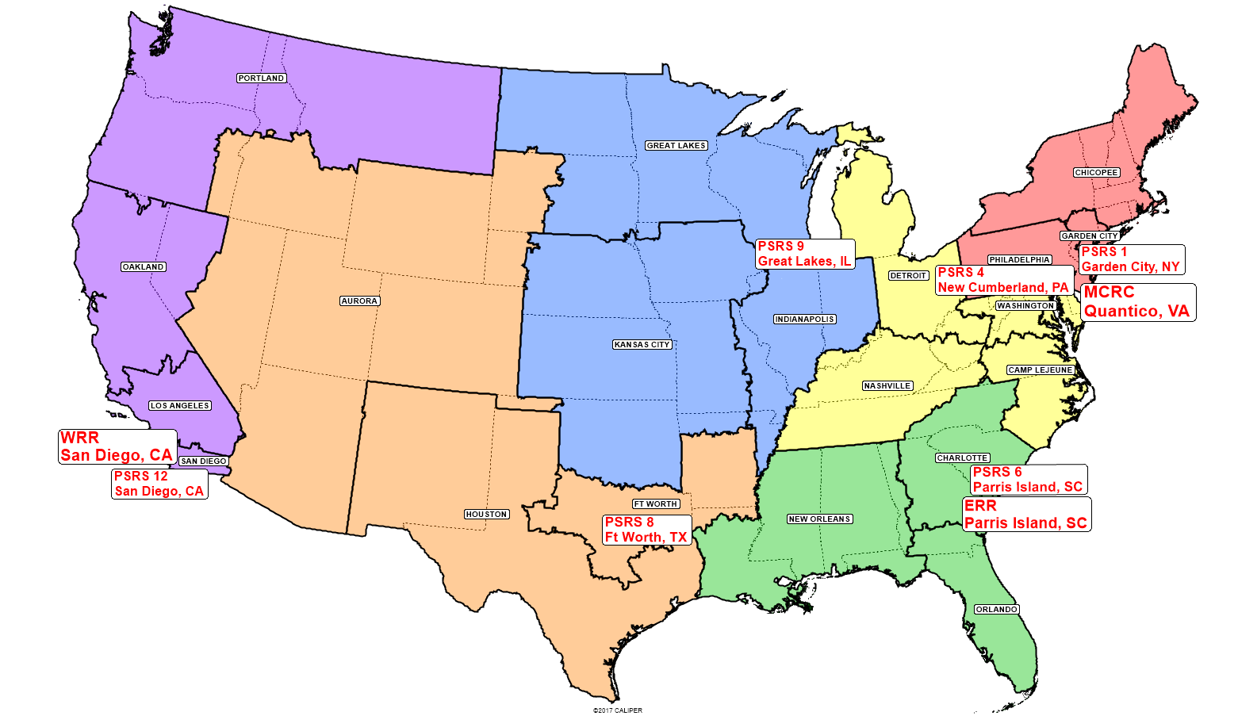
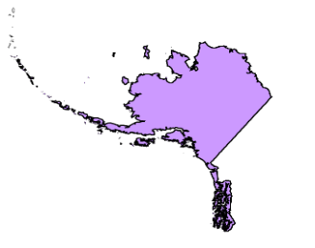
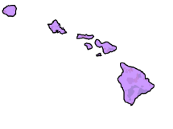

PSR Structure
Alaska (PSRSS Portland)
Hawaii (PSRSS San Diego)
Puerto Rico (PSRSS Orlando)
Notes:
Current structure represents FY16 NSWG authorized structure changes, which were completed at the beginning of FY19
Regional structure breakout is now 41 ERR/40 WRR for 8411 structure
PSRS boundaries generally follow district boundaries with a few minor exceptions (the largest being PSRS1 NOT including Baltimore area)

Slide 5
MCRC PSR Staff
MO: 2
ME: 4
Branch Head
LtCol Green, M.
Deputy Branch Head
Maj Torres, J.J.
PSR Training Chief
MGySgt Sicilia, V.T.
Branch Chief
MGySgt Lynch, A.J.
Operations Chief
MSgt Samperisi, D.A.
Data Chief
GySgt Ostermann, J.A.
Notes:
We are small, but we cover a lot.
The PSR section has a lot of characteristics associated with RS-level Ops. Due to the fact that all PSR waivers, bonuses, reenlistment and retrain requests are adjudicated at RA, not at the District, Region, or MCRC, they have pretty massive processing responsibilities.
Due to our small numbers, they maintain RSS-level stats for comparative purposes that would normally be maintained at the RS or district
They do all that through the prism of the MCRC command structure, working through regions and PSRS Hqs.

Slide 6
PSR Distribution
PSR Staffing: Off / 8422 / 8421 / Support
CG, MCRC
Total: 140
Officers: 10
Career Recruiter (8422): 39
Recruiter (8421): 76
Enlisted Support: 15
AC/S G-3
MCRC PSR Staff
2 / 2 / 0 / 1
NTT
0 / 1 / 0 / 0
Recruiters School 0 / 2 / 0 / 0
CG, ERR
CG, WRR
ERR PSR Staff
1 / 1 / 0 / 1
WRR PSR Staff
1 / 1 / 0 / 1
1 MCD
4 MCD
6 MCD
8 MCD
9 MCD
12 MCD
PSRS – 01
1 / 5 / 13 / 2
PSRS – 04
1 / 6 / 15 / 2
PSRS – 06
1 / 5 / 10 / 2
PSRS – 08
1 / 5 / 11 / 2
PSRS – 09
1 / 5 / 10 / 2
PSRS – 12
1 / 6 / 17 / 2

Slide 7
HQ Primary Responsibilities
Enduring mission planning, coordinating, and liaison with
HQMC Reserve Affairs (RA)
Marine Forces Reserve (MFR)
MCRC Recruiting Regions / Districts
Process and track all PSR issues adjudicated at HQMC RA
Waivers (tattoos, moral waivers)
Bonuses
Retrains (Lateral Moves)
Re-enlistments
PSR Manpower Management
8422 (PS Career Recruiter) and 8421 (PS Recruiter) Management
PS Recruiting Station (PSRS) Officer-in-Charge slating
PSR, SMCR units, and IMA detachment communication and collaboration
Attrition Management
SMCR affiliations who do not remain in the SMCR longer than 60 days following join by a Prior Service Recruiter

Slide 8
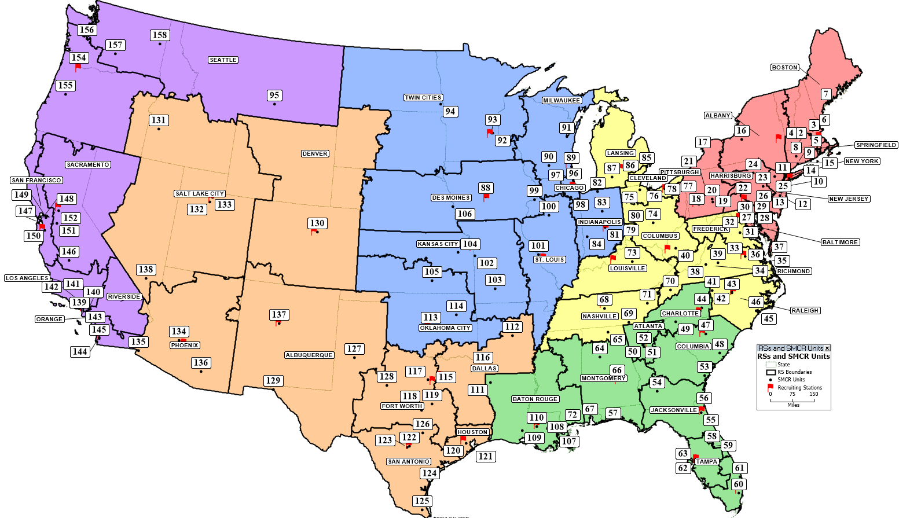
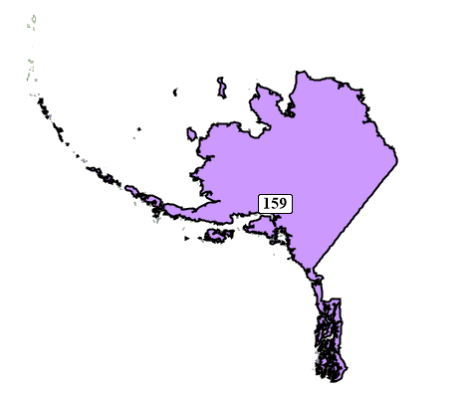
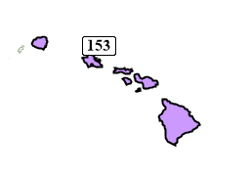
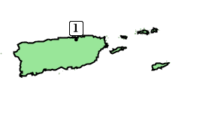
Operational Environment
Reserve Units

Slide 9
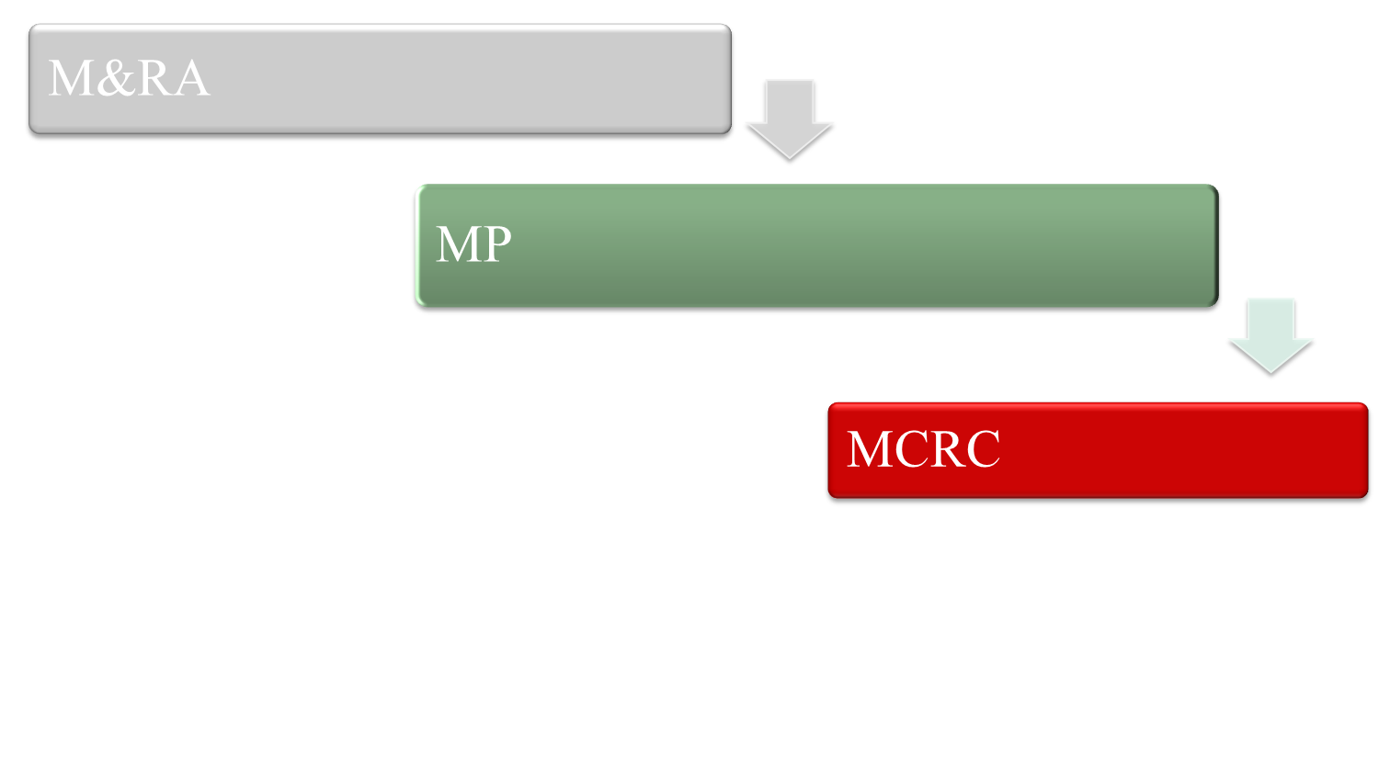
Mission Management Process
Policy & Guidance
Recruiting Mission
Memo’s
/ RESERVE AFFAIRS
End Strength Goals
Accession Requirements
Programs (PEF / Contracts)
EAS / Non-EAS Attrition
FTAP / STAP Retention
Reserve Requirements
Planning Guidance + Execution
Operation Plans
Regulars (Active Duty)
Reserves
Officers
Prior Service
Notes:
P&R Note:
M&RA distributes policy and guidance to the CMC’s intent on various issues from diversity to the rate at which we will build or reduce end strength to funding available for accession and retention incentives.
MP converts this policy and guidance into all end strength goals using various models to predict cohort attrition. It applies accession and retention incentives to affect the model predictions to achieve a good balance between annual additions from new accessions and from retention of both first term and subsequent term Marines. It publishes retention and accession goals.
MCRC converts MP guidance from the memorandums into annual mission requirements between regular, reserve, officer (regular and reserve), and prior service accessions. MCRC’s plans include guidance on rates and quality of accessions throughout the year and on requirements for specific markets – diversity, musician, etc. The annual operation orders publish this guidance to the regions who provide their input to the order as to how they intend to execute the requirements.

Slide 10
FY23/24 PSR Mission
FY23 Accessions
FY24 Mission
 | SMCR O | SMCR E | IMA | AR | OPEN | Total
Mission (Memo 4) | 310 | 3221 | 345 | 212 | 399 | 4487
Achieved | 310 | 3221 | 345 | 212 | 399 | 4487
 | SMCR O | SMCR E | IMA | AR | OPEN | Total
Mission (Projected) | 247 | 2430 | 275 | 233 | 318 | 3503
Projected | 247 | 2430 | 275 | 233 | 318 | 3503
FY23 Highlights
FY24 Future Look
2 x In-year mission increases:
543 & 100 (Total 643)
17% mission increase from start of FY
FY23 MCRC PSR Average APR - 4.68
FY23 DAP Joins to date: 904
FY22 DAP joins: 519
3503 IRR accession mission
DAP no longer a PSR tool
MMEA/MEF DAP mission: 2000 Approved Packages
8421 T/O Reduction: 100 to 76 (MM DAP Cell tax)
Pre-Coordinated with RAM for 10% overstaff to aid w/ transition and T2P2
MCRC accomplished the FY23 PSR mission with 2 in-year increases. The FY24 mission will decrease, but with a PSR 8421 reduction of 26% (transferred to MM DAP cells) FY24 will be challenging. Expect a surge in the beginning of the FY that tapers off as we naturally attrite (PCS) remaining excess recruiters.
CAO: 20231012

Slide 11
IRR to IMA Join Process
PS Recruiter
Individual Marine Augmentee (IMA) Operational Sponsor
Marine Corps Individual Reserve Support Activity (MCIRSA)
Marine
Identify a Billet Identification Code (BIC) vacancy in the Inventory Development and Management System
BIC must be “ADVERTISED”
Conduct interview with Marine ⁴
MFR CSC conducts all unit diary actions for IMA affiliations. ⁵
Coordinate drill schedule with IMA Operational Sponsor or Unit Command. Meet drill requirements. ⁶
Accept Applicant
- Or -
Reject Applicant
Endorsement is used in lieu of NJW
If rejected: IMA sponsor must provide justification and PSR may request ROA join credit from MCRC.
Recruit/screen applicants from the IRR. ¹
PS Marines must meet the moral, medical, and professional standards for SMCR/IMA affiliation.
Applicant must meet any/all additional billet requirements that are identified. ²
Accepted: Endorsement is returned to PSR and affiliation package is forwarded to MCIRSA via PSRS Ops Chief.
Rejected: ROA must be sent to IMA Program Manager (RA) for validation.
Route BUMED waiver to RA via MCRC Portal .³
Complete an affiliation package and send to the Operational Sponsor for acceptance or rejection.
Applicant’s medical screening must go through BUMED via Webwave portal.
Billets may require additional qualifications i.e. Proof of Security Clearance, Limited to Local Area, Additional MOS requirements, etc.
CMC (RA-RAM 3) must adjudicate every RE-3P waiver. MCRC does not need to endorse; PSRs can send directly to RA for expedience.
IMA Operational Sponsor has (10) business days to accept or deny package. IMA detachments are able to conduct interviews.
MFR CSC has 7-10 business days to run and certify diary actions.
PSR’s, in conjunction with the gaining unit, will ensure newly joined Marines attend drill weekend(s). At a minimum, the new join must remain in the unit for a period of 61 days or more in order to avoid attrition.

Slide 12
IMA Screening Process
Screening Tools:
-Initial Screening Checklist (37 screening questions)
-Tattoo Screening Form (Uncovering tattoo waiver)
-DD 2807 Report of Medical History (Current Ht/Wt/HIV results)
-Statement of Understanding (Illegal Drug use/HIV)
-New Join Worksheet/IMA OpSponsor Letter/MCTFS screens
* PSRs may provide an RQS to the OpSponsor as a courtesy. (not required)

Slide 13
Q3: Qualified Mentally, Morally, Physically
Q3 - what is required
RE Codes: 1A, 1B, 1C, 3N, 3O, 3S, 3V
Within height and weight standards
Medically ready (2807)
No reporting probation
Q3 - what is not required
Current rifle/pistol score
Current PFT/CFT
PME complete
Pro/Con marks or fitness report over certain value
Clean record with no NJPs, etc.

Slide 14
PSR and IMA Relations
Highly recommend adding reasonable remarks
Screen and respond appropriately (10 days)
- Still requires processing by MCIRSA for join (6 business days)
Return NJW or detailed email with reasons for rejection of applicant
Accurately advertise BICs
- MCRC is not on RTAMMS so must use IMA BIC report
- PSRs can only recruit off of advertised tab cannot see open tab on
BIC report.
- Delay from moving BIC from open tab to advertised tab causes delay
in processing and join.

Slide 15
Rejection of Accession (ROA)
Process that awards MCRC PSR join credit for qualified applicants that are rejected by IMA detachment.
IMA ROA credit is defined in RA Join Credit Policy.
Common factors that result in ROA processing:
Lengthy accession decision times.
Advertised BICs that are already filled or pending join.
Additional qualifications desired, but not captured on the IMA Open BIC Report.
PSRS OICs are required to attempt to make contact with entity processing accession decision prior to submitting ROA.

Slide 16
Points of Contact
MCRC PSR HQ
Branch Head | LtCol Green, M. | 571-559-4635
Deputy Branch Head | Maj Torres, J.J. | 703-784-9868
Branch Chief | MGySgt Lynch, A.J. | 703-784-9900
Operations Chief | MSgt Samperisi, D.B. | 703-784-9900
Eastern Recruiting Region
ERR Branch Head | Maj Jurczynski, C.J. | 843-228-4751
PSRS-01 (Northeast) | Maj Saglimbene, R. | 516-824-3092 / 413-519-0337
PSRS-04 (Mid-Atlantic) | Maj Gates Jr., P.J. | 717-770-8103
PSRS-06 (Southeast) | Maj Patrone, W.T. | 843-228-4437 / 678-655-3418
Western Recruiting Region
WRR Branch Head | Maj Morgan, J.K. | 619-524-8809
PSRS-08 (Southwest/Central) | Maj Brown Jr., P.L. | 817-738-6260
PSRS-09 (Midwest) | Maj Muma, C.A. | 847-857-6181
PSRS-12 (West Coast) | Maj Mohler, R.A. | 760-763-3524
Notes:
The PSR mission is developed by HQMC RA and published by DC M&RA via formal memo.
In-Year changes are conveyed through pre-coordinated formal changes to the memo.
We also coordinate with MFR G-1 and G-8 ICW RA for manpower and reserve structure-related issues such as RF 2025 and FSRG type-initiatives
We work directly with MCRISS G-3 for MCRISS PSR refinement, to include MCRISS 2.0

Slide 17
QUESTIONS

