Slide 1

Individual Mobilization Augmentee (IMA)
Program Brief
IMA Program Manager
RAM-3, M&RA

Slide 2

Agenda
RA Overview
DoD IMA Policy
Marine Corps IMA Program
Authorized Manning
Hiring/PSR/DAP
IMA Assignment Policies
IMA Funding
References
Contacts

Slide 3
Reserve Affairs
Overview

Slide 4
Manpower & Reserve Affairs
Commandant of the Marine Corps (CMC)
Manpower Management (MM)
Manpower Plans & Policy (MP)
Marine & Family Programs (MF)
Reserve Affairs (RA)
Manpower Information (MI)
Wounded Warrior Regiment
Deputy Commandant for Manpower & Reserve Affairs (DC, M&RA)
Notes:
Marsh Center – 5th floor

Slide 5
Reserve Affairs Management
Director RA
MajGen Pierson
Deputy Director RA
BGen Armas
Sergeant Major RA
SgtMaj Bedran
Reserve Affairs Management (RAM)
Branch Head Col Donahue
Reserve Affairs Policy (RAP)
Branch Head Col Perazzo
Dep Branch Head LtCol Frye
Dep Branch Head LtCol Simpson
RAM-1
Accessions, Retention, & Training
RAM-2
Assignments
RAM-3
Programs & Data Management
RAM-4
ROCP
RAP-1
Policy
RAP-2
Personnel Plans
RAP-3
Programming
UNCLASSIFIED
Notes:
Introduce team

Slide 6
Reserve Affairs Management - 3
Provide overall management for the IMA Program
  Coordinate IMA Structure changes with TFSD
  ASR = ~9k pieces of IMA structure
    Authorized Manning (paychecks) allocated from RAP
    FY24 = 2328 paychecks
  Coordinate IMA Structure changes with TFSD
  RTAMMS Manager
Conduct & support Reserve Affairs sponsored selection boards
  Reserve Command Screening (LtCol/Col/RSLB)
  Reserve PME/GEP
  AR Officer Accession/Career Designation
  Reserve Sergeants Major Slate
  AR 2P SNCO Continuation
Provide Service-level JOM support for Reserve Component Marines
UNCLASSIFIED
Notes:
Introduce team

Slide 7
IMA Overview

Slide 8
DoD IMA Policy
DoDI 1235.11 – Management of IMAs
DoD Policy:
Individual Reserve Component (RC) military billets augmenting the Active Component (AC) structure of the DoD or other departments / agencies of the U.S. Government may be validated for fill with members of the Selected Reserve in an IMA Program to support:
  Service Mobilization Requirements
  Service Contingency Operation Requirements
  Service Operations Other Than War Requirements
  Other specialized or technical service requirements

Slide 9
DoD IMA Policy
DoDI 1235.11 – Management of IMAs
Assignment of IMAs:
IMAs are assigned against validated RC billets that are identified on AC force structure documents for fill by RC members.
IMAs will not be assigned to units of the RC force structure.
IMAs will not be authorized or assigned to vacant positions designated for fill by AC military personnel or DoD civilian personnel.

Slide 10
DoD IMA Policy
DoDI 1235.11 – Management of IMAs
Training Requirements of IMAs:
IMAs will participate in training activities with the organization to which they are assigned or attached.
IMAs must perform a minimum of 12 days annual training each year.
  IMAs will perform annual training with the organization to which they are assigned or as authorized by that organization, in accordance with Military Service policy.
IMAs are only required to perform the amount of IDT necessary to satisfactorily perform assigned duties.

Slide 11
Marine Corps IMA Program
MCO 1001.62C – IMA Program
HQMC (RAM) exercises overall IMA program management responsibility for the Service.
Organization:
Operational Groups (OpGroups)
  14 OpGroups
  Organized under Program Managers (AR officers)
  Generally aligned with the Active Component organizational hierarchy
Operational Sponsors (OpSponsors)
  Organizations with IMA structure required to appoint an OpSponsor
  Represent & facilitate the IMA Marines’ participation with the unit
  Oversee compliance with requirements

Slide 12
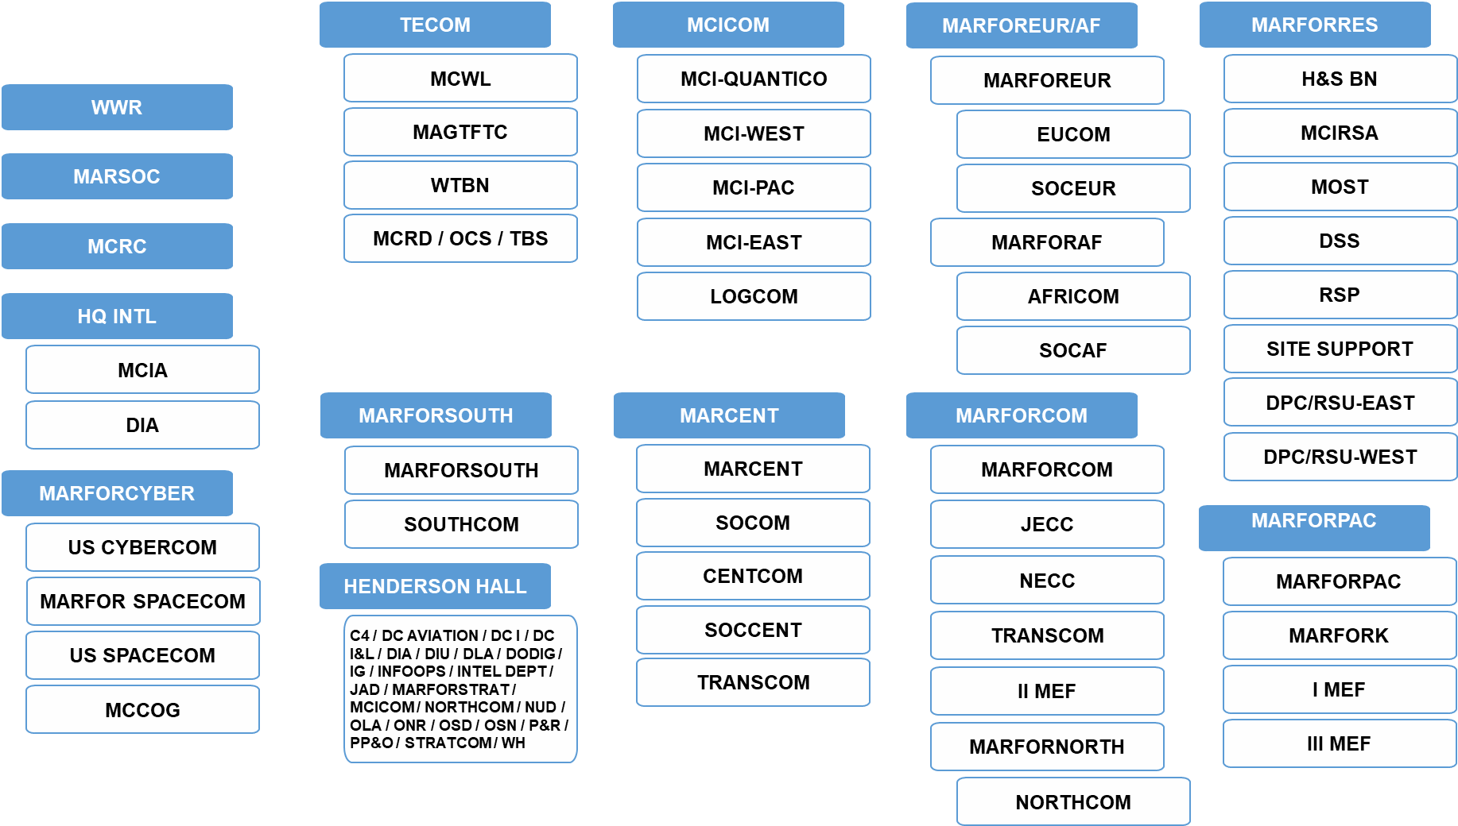
IMA Program Organization
(14) OpGroups aligned with AC Organizations

Slide 13
RESERVE COMPONENT STRENGTH
RESERVE PERSONNEL PLANS | MANPOWER & RESERVE AFFAIRS
FY24’s Reserve Non-Prior Service recruiting mission of 3,000 is historically low (down from ~5,500) and aimed at replenishing their start pool. MCRC is on pace to achieve its mission and has limited between-trimester QSN swaps, keeping the IADT end strength forecast stable.
Data as of March 2024

Slide 14
Structure vs. Authorized Manning
IMA Structure
  IMA Program authorized to fill a portion of the total IMA structure
  Each unit is authorized to fill a portion of their IMA structure per the T/O
Authorized Manning (AM)
  Number of IMA BICs that can be filled in a unit
FY20 AM: 2,586
FY21 AM: 2,538
FY22 AM: 2,358
FY23 AM: 2,306
FY24 AM: 2,328
Total IMA Structure = 8,852

Slide 15
FY24 Authorized Manning “Paychecks”
FY24 Authorized Manning = 1,636 Officers / 692 Enlisted / 2,328 Total
OPGROUP | OFF AM | OFF O/H | ENL AM | ENL O/H | AM TOTAL | O/H TOTAL
HENDERSON HALL | 304 | 294 | 35 | 34 | 339 | 328
HQ INTEL | 19 | 16 | 4 | 3 | 23 | 19
MARCENT | 43 | 50 | 21 | 26 | 64 | 76
MARFORCOM | 173 | 168 | 49 | 45 | 222 | 213
MARFORCYBER | 98 | 92 | 61 | 47 | 159 | 139
MARFOREUR/AF | 71 | 73 | 21 | 20 | 92 | 93
MARFORPAC | 303 | 324 | 91 | 88 | 394 | 412
MARFORRES | 148 | 155 | 230 | 231 | 378 | 386
MARFORSOUTH | 25 | 29 | 8 | 9 | 33 | 38
MARSOC | 30 | 35 | 7 | 13 | 37 | 48
MCICOM | 95 | 106 | 68 | 60 | 163 | 166
MCRC | 84 | 95 | 9 | 10 | 93 | 105
TECOM | 243 | 245 | 86 | 90 | 329 | 335
WWR | 0 | 0 | 2 | 2 | 2 | 2
TOTAL | 1636 | 1682 | 692 | 678 | 2328 | 2360
*This does not reflect Marines that may have already executed a “paycheck” (AT), then
transferred to the IRR or IUT to a different unit.

Slide 16
Prior Service Recruiting (PSR) and Direct Affiliation Program (DAP)
MCRC PSR has a mission to recruit prior service Marines from the IRR into the Selected Reserve (SMCR and IMA).
DAP - Career Planners (CP) have a mission to recruit active-duty Marines, prior to EAS, into the Selected Reserve (SMCR and IMA).
Advertised List
  Advertise billets in IDMS to hire to 100% of AM
    Signals PSRs and CPs to recruit to that billet
    Posted on the MFR and RAM-3 website
  Ensure all categories are filled out (POC information, remarks, etc.)
  Remarks should be descriptive but valid
    If in the IRR, Marines are not required to have a current PFT, CFT, PHA, etc.
    Must have TS-SCI
    Advertised for “Maj Smith, Johnson”
Rejection of Accessions (ROA)
  Rejection of a qualified applicant on a New Join Worksheet will trigger a ROA
  All IMA ROAs are reviewed by RAM for concurrence
  Multiple ROAs from the same command may impact AM allocation
  ROAs not applicable for unadvertised billets (including DAP)

Slide 17
IMA Assignment Policies

Slide 18
Assignment Policies
Per HQMC Drilling Reserve BIC Assignment and Management Policy, IMA Marines will be assigned to billets commensurate with their MOS & grade (+/-)
  Colonels are not authorized to fill O5 billets
  E8s are not authorized to fill E7 billets
  E9s are not authorized to fill E8 billets
1stSgt/SgtMaj limited to serve in 8999 BICs (assigned by RA)
Non-Prior Service applicants cannot be recruited to the IMA
IMA Marines who are also DoD civilian employees may not hold an IMA assignment to the same position that they hold as civilian employees.
Standard IMA tour length is three years
  Commands may request extensions beyond the standard three year tour, in one year increments, not to exceed five consecutive years.
  Exceptions: MOU with JAD / DoD Memo for VA-01

Slide 19
IMA Assignment Policy
MARADMIN 214/19 –cancelled
  Restricted Officers
  Company Grade Officers
  Aviators
  NMOS 0577
MARADMIN 005/24 –cancellation of MARADMIN 214/19
All assignment policies will be captured in the annual HQMC BIC Assignment and Management Policy.

Slide 20
IMA Funding

Slide 21
1108 Funding
1107 Funding:
  IDT Lodging reimbursements for IMAs residing greater than 50 miles from HTC
  Separate, Reserve specific organizational hierarchy established within DTS
  IMA Marines must have a DTS Reserve profile managed under the Command’s DTS Reserve organizational hierarchy
  FMO issue funding letter to IMA PM to disperse to OpGroup Managers/Comptrollers
  Each OpGroup has its own Task in DAI that pulls funds from the IMA Program Project (M40084_241107_AIM00M40084)
1108 Funding:
  AT, AT travel, off-site IDT
  Funds passed directly from P&R to AC commands
  P&R issue funding letters directly to command comptrollers and OpGroup Managers
  Additional ATs and Extended ATs
  AT travel and off-site IDT is passed through DAI
  Pay and Allowances (P&A) AT funds are loaded into MROWS by the comptrollers

Slide 22
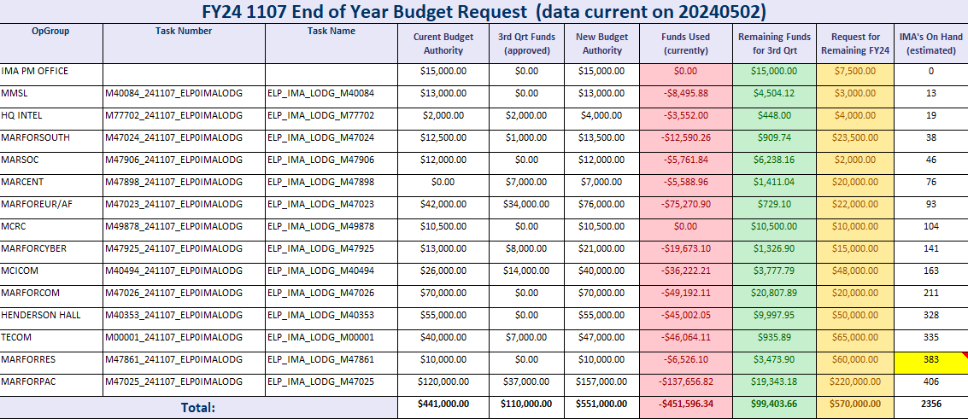
1107 Funding
The OpGroup will notify their comptrollers of increased budget authority, comptrollers load additional funds into DTS, OpGroup verifies LOA funds are loaded in DTS to prevent failure.

Slide 23
1108 Funding
P&A are for your AT orders that are generated in MROWS, per funding letter.
Off-Site IDT Travel and AT Travel
  Funds are passed through DAI by P&R as the L1 to the respective L2s. The L2s are expected to properly pass the necessary funds to their L3s & L4s.
  The Planning Estimate letters detail your total authority by QTR. OpGroups will need to split the total funding between DTS/MROWS, as appropriate to meet mission requirements.
    Off-Site IDT travel is completed via MROWS
    AT Travel is completed through DTS
  Remember MROWS (and DTS LOAs) are merely systems which allow you to set limits, but the actual PD&T travel funds are in DAI which is your real money. This is where a lot of issue arise. This split between MROWS and DTS is something each unit tracks internally to meet their mission. P&R and M&RA do not track the splitting of PD&T funds down to that level.

Slide 24
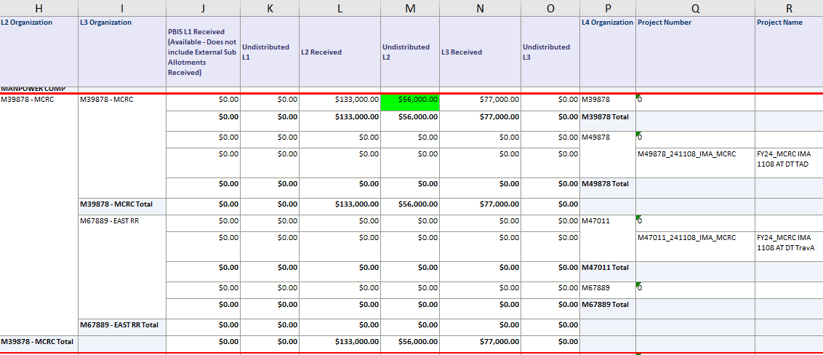
1108 Funding
When P&R passes Off-Site IDT and AT Travel funds through DAI, it will be
placed in your L2. OpGroups need to inform their comptrollers to move it to
the L3 and L4.

Slide 25
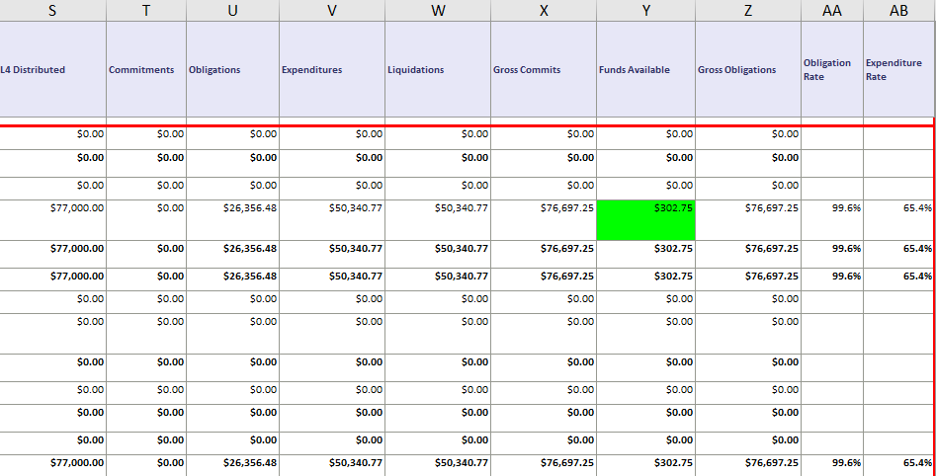
1108 Funding cont..

Slide 26
References
DoDI 1235.11 - Management of IMAs
MCO 1001R.1L with Change 1 - MCRAMM
MCO 1001.6C - IMA Program Order
MARADMIN 214/19 - IMA Assignment Policy (pending cancellation)
IMA Handbook

Slide 27
Contacts
IMA Program Manager
  MSgt McKay; joshua.mckay@usmc.mil; 703-432-9767
IMA SNCOIC
  SSgt Wright; jaquil.wright@usmc.mil; 703-784-9149
IMA Clerk
  Sgt Sanchez; jessica.sanchez1@usmc.mil; 703-784-5513
Organization Mailbox: SMB_IMA@USMC.MIL

Slide 28
Questions?

